Slide 1
DocSpot:Seamless Appointment Booking For Health

Slide 2
Introduction to DocSpot
DocSpot is a digital platform designed to simplify appointment scheduling in healthcare.
It connects patients with healthcare providers through an easy-to-use interface.
The platform aims to improve access and efficiency in healthcare services.
Notes:
Image source: https://keybotix.com

Slide 3
The Need for Seamless Appointment Booking
Patients often face challenges in finding available appointment times with their providers.
Healthcare providers struggle with managing appointments and reducing no-shows.
Seamless booking solutions can enhance patient satisfaction and operational efficiency.
Notes:
Image source: https://keybotix.com

Slide 4
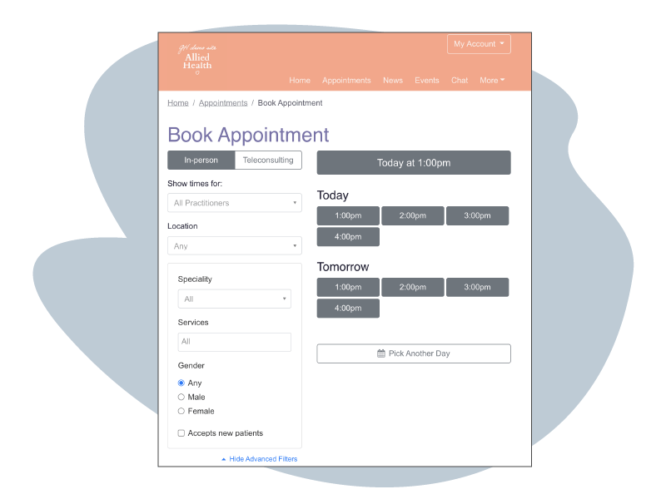
Core Features of DocSpot
Real-time appointment availability updates for multiple healthcare providers.
User-friendly interface for patients to book, reschedule, or cancel appointments.
Integration with existing healthcare management systems for streamlined operations.
Notes:
Image source: https://www.hothealth.com

Slide 5

Benefits for Patients
Simplifies the process of booking healthcare appointments anytime, anywhere.
Provides transparency regarding available slots and provider details.
Reduces waiting times and improves overall patient experience.
Notes:
Image source: https://www.experian.com

Slide 6
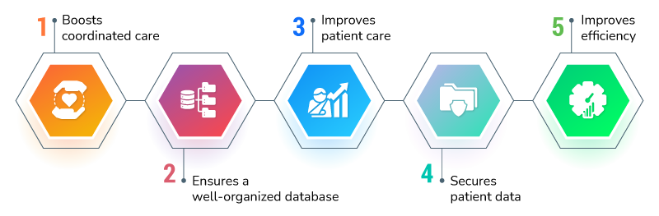
Benefits for Healthcare Providers
Automates appointment scheduling, reducing administrative workload.
Helps decrease no-shows through automated reminders and confirmations.
Enhances patient engagement and loyalty through accessible booking options.
Notes:
Image source: https://www.rightpatient.com

Slide 7
How DocSpot Works
Patients select their preferred healthcare provider and available time slots on the platform.
The system confirms bookings instantly and sends automated notifications.
Healthcare providers receive real-time updates to manage their schedules efficiently.
Notes:
Image source: https://keybotix.com

Slide 8

Security and Compliance
DocSpot adheres to healthcare data privacy standards like HIPAA.
The platform employs encryption and secure login protocols to protect patient information.
Regular audits and updates ensure ongoing compliance and security.
Notes:
Image source: https://backend.vlinkinfo.com

Slide 9
Case Studies & User Feedback
Several clinics reported a 30% increase in appointment bookings after implementing DocSpot.
Patients expressed high satisfaction due to faster and more convenient scheduling.
Healthcare providers noted improved operational efficiency and reduced administrative costs.
Notes:
Image source: https://keybotix.com

Slide 10

Future Developments
Integration of telehealth appointment booking features.
AI-powered scheduling to optimize appointment slots and reduce wait times.
Expansion to include additional healthcare services and specialties.
Notes:
Image source: https://cdn.shopify.com

Slide 11
Conclusion
DocSpot offers a seamless, efficient solution for healthcare appointment booking.
It benefits both patients and providers by simplifying the scheduling process.
Embracing digital booking platforms like DocSpot can transform healthcare accessibility and quality.
Notes:
Image source: https://www.slidemake.com

